Slide 1
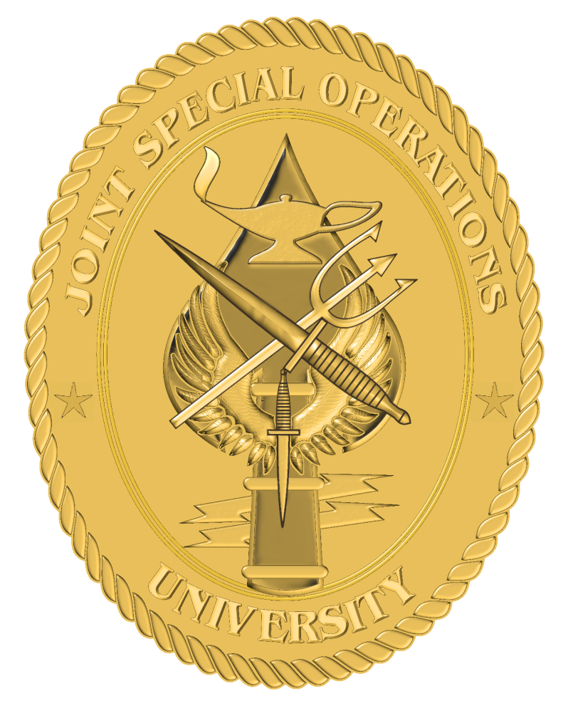
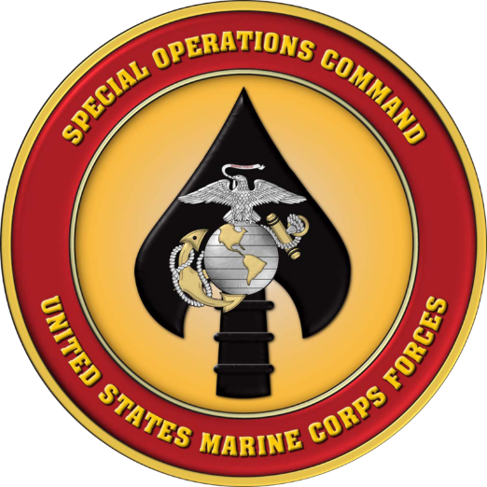
Joint Special Operations University
Religious Support Team Orientation
MARSOC RST Overview
CAPT Lee Axtell, CHC, USN
LCDR Phillip Hogan, CHC, USN RP1(FMF) Timothy Cambiado, USN

Slide 2
MARSOC Service Culture
LT Stephen Decatur, Jr. (1804)
WWII 1st & 2nd Marine Raider Battalions
Always faithful • Always forward • Silent Warriors
"Spiritus Invictus"
Notes:
The foundation and legacy of the Marine Corps and the Special Operations Forces Truths inspire the genesis, intent, and purpose of MARSOC.
Lieutenant Presley O’Bannon’s battle against the Barbary Pirates on the shores of Derna Tripoli in 1805 (as described in the Marines’ Hymn) began a reputation as a versatile force in readiness for our Nation’s strategic interests.
The experiences of legends such as Chesty Puller, Smedley Butler, Dan Daly, and John Lejeune during the Banana Wars were captured in The Small Wars Manual – originally published in 1935 – that still informs approaches to counterinsurgency, foreign internal defense and other SOF activities today.
One of the Marine Corps’ most notable units to conduct special operations before the formation of MARSOC were the Marine Raiders – specially screened and assessed Marine volunteers who received unique training and equipment to perform the most challenging missions in remote, ambiguous, and complex environments with little to no support.
After World War II, Marine Force Reconnaissance units carried on the legacy of the Marine Raiders and the innovations of units such as Marine Corps Test Unit 1, which developed specialized tactics and techniques for the nuclear age, including revolutionary employment concepts for the helicopter. Force Recon units created much of its well-known history in Vietnam, participating in Key Hole (information gathering) and Stingray (direct action) operations and continue to perform deep reconnaissance and direct action missions in support of Marine Expeditionary Forces today.
In conjunction with the creation of U.S. Special Operations Command in the late 1980s, the Marine Corps enhanced its existing Marine Amphibious Units (MAUs) – later referred to as Marine Expeditionary Units (MEUs) – to include special operations capabilities. For the next 20 years, the MEU(SOC) units catalogued an impressive list of independent, joint, and combined operations.
Shortly after the 9/11 attacks, the Marine Corps reactivated the 4th Marine Expeditionary Brigade (Anti-terrorism). Tasked to provide Combatant Commands with rapidly deployable and sustainable anti-terrorism forces, the 4th MEB (AT) was quickly put into action, as elements relieved the 26th MEU (SOC) to provide security to the U.S. Embassy in Kabul, Afghanistan in December 2001.
At the onset of the Global War on Terrorism, Secretary of Defense Donald Rumsfeld directed the Marine Corps to create a component within SOCOM. Marine Corps/USSOCOM Detachment 1 (Det 1) activated in 2003 and subsequently deployed in support of Operation IRAQI FREEDOM as a proof of concept that ultimately informed several aspects of MARSOC’s organization, training, and concept of employment.
As the Marine Corps sought to define its contribution to SOCOM, the Foreign Military Training Unit was activated at Camp Lejeune, NC in October 2005 to conduct foreign internal defense assistance to developing countries. FMTU conducted successful deployments to South America, Africa, and Europe; upon joining MARSOC, FMTU was re-designated Marine Special Operations Advisory Group.
On 23 February 2006, U.S. Marine Corps Forces, Special Operations Command was activated at Camp Lejeune, NC, formed with a small staff from 4th Marine Expeditionary Brigade (Anti-Terrorism), the Foreign Military Training Unit, and 1st and 2d Force Reconnaissance Companies. Seven years later, and after several reorganizations, MARSOC has grown into its current organization of roughly three thousand personnel organized into a Marine Special Operations Regiment (MSOR), Marine Special Operations Support Group (MSOSG), Marine Special Operations School (MSOS), and the component headquarters.

Slide 3
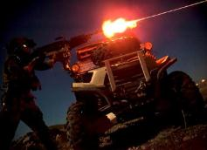
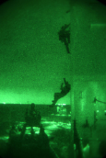
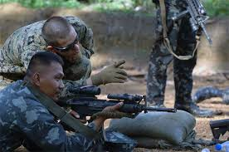
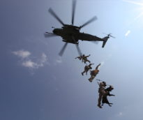
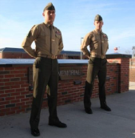
MARSOC Missions
Security Force Assistance
Counterterrorism
Foreign Internal Defense
Direct Action
Special Reconnaissance
Preparation of the Environment
Counterinsurgency
How is MARSOC different?
Missions by direction of the SOCOM Commander
Irregular and unconventional settings
Additional training w/ SOF equipment & TTPs
USMC Recon conducts missions as part of the MAGTF in support of conventional operations.

Slide 4
Component Comparison
USASOC
Special Forces
Rangers
Spec Ops Aviation
MISO
Civil Affairs
AFSOC
Spec Ops Wing (SOW)
Spec Tactics Sqdns (STS))
(54%)
(26%)
(5%)
(15%)
MARSOC
Marine Special Ops Companies (MSOCs)
NAVSPECWARCOM
SEALs
Special Boat Unit (SBU)

Slide 5
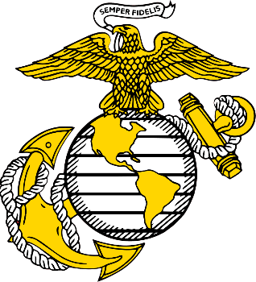
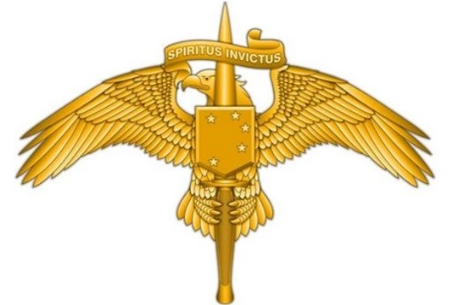
MARSOC Mission
“Marines are who we are, Special Operations are what we do!”
MARSOC
MRTC
MRR
MRSG
A Title 10 organization, charged with recruiting seasoned Marines in order to organize, train, equip, and deploy them in task organized, scalable and responsive Marine Corps Special Operations Forces (MARSOF) worldwide to accomplish Special Operations missions assigned by CDRUSSOCOM, and/or Geographic Combatant Commanders employing SOF.
Direct Action – Special Reconnaissance – Foreign Internal Defense
5
Notes:
MARSOC has a Title 10 mission to man, train, equip, and deploy Marine Corps Special Operations Forces (MARSOF).
What’s notable here is that MARSOC recruits from within the Marine Corps – MARSOC does not have a “street-to-fleet” program where an individual can enlist, go to boot camp and then screen for selection. Instead, MARSOC recruits seasoned Corporals, Sergeants, First Lieutenants, and Captains who’ve already had a successful tour in the Corps and are endorsed by their chains of command.
This is why we say, “Marines are who we are, Special Operations are what we do”.

Slide 6
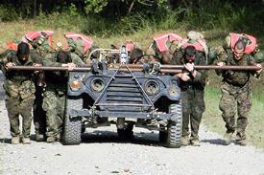
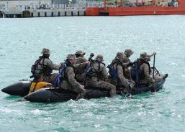
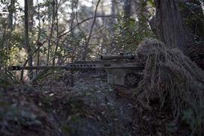
Marine Raider Training Center
Assess, select and train Marines and sailors for assignment as MARSOF; provide basic and advanced special operations skills training; and validate MARSOF TTPs to train and produce basic knowledge level Critical Skills Operators and develop advanced special operations skills in the force.
MARSOC
MRTC
MRR
MRSG
Assessment and Selection
Individual Training Course
SOF Level I and II Courses

Slide 7
Marine Raider Training Center
21 Days
19 Days
Assessment & Selection Phase I
Assessment & Selection
Phase II
Recruit
Screen
Well Trained, Mature Marines
Select
Operating
Forces
24 weeks
Advanced/
Specialty Skills
Courses
037x MOS Awarded
Individual Training Course
Basic Language Course (BLC)
0372
0370
Tm Cmdrs Seminar
Tm Cmdrs Course
4 Weeks
36 Weeks
Notes:
-IAW SOCOM direction and MARSOC mission guidance letter (30) Oct, 2006 Marine Special Operations School conducts a A&S to determine qualified candidates for Marine Special Operations Teams (MSOT)
Training pipeline for 0370/0372 MOS. Of Note:
-- No direct “street to fleet”. We recruit Senior Cpls, Junior Sgts, senior 1st Lts, junior Capts, all with proven track records. Recruit from all MOS’s. -- 2 stage A&S. First stage includes mentoring, feedback, tests of existing, tangible skills (physical and mental). Phase 2 is off site and is very ambiguous; no feedback, tough problems with no real solutions, examines how someone thinks.
-- ITC is MOS producing school: officers are 0370, enlisted are 0372 -- Language pipeline has produced 100% 1/1 or better. Languages based on Bn orientation
CMDR EMPHASIS: Marine Corps has been very supportive of Primary MOS in promotion, retention.

Slide 8
Marine Raider Regiment
Man, train, equip, and deploy task organized scalable expeditionary MARSOF worldwide to accomplish the full range of special operations missions in support of combatant commanders.
MARSOC
MRTC
MRR
MRSG
1st MRB
2d MRB
3d MRB

Slide 9
Marine Raider Regiment
Enabling Capability
Combat Support
EOD Technicians (x 4)
Joint Terminal Air Controller (x 3)
Multi-purpose Canine Teams (x 2)
Combat Service Support
Logistics Officer
Logistics Chief
Riggers (x 2)
Supply Administrators (x 2)
Boat Mechanics (x 2)
Electrician
Generator Mechanic
Precision Weapons Technician
Embarkation Specialist
Motor Transport Maintainers (x 2)
Ammunition Technician
Marine Special Operations Company Headquarters
Commanding Officer (Major)
Executive Officer (Captain)
Senior Enlisted Advisor (First Sergeant)
Administrator (Corporal)
Intelligence Officer (Captain)
Operations Chief (Master Sergeant)
Operations (Gunnery Sergeant)
Air Officer (Captain)
Logistics Chief (Gunnery Sergeant)
Communications Chief (Gunnery Sergeant)
Radio Operator (Sergeant)
Medical Chief (Hospitalman Chief)
Intelligence Direct Support Team
Officer in Charge
Human Intelligence Officer
Human Intelligence Specialists (x 4)
Signals Intelligence Specialists (x 8)
Intelligence Analysts (x 5)
Geospatial Intelligence Specialists (x 2)
Command, Control, Communications, Computers Support Team
Data Chief
Data Specialists (x 6)
Satellite Specialist
Radio Operator
Maintenance Specialist
Marine Special Operations Team
Team Leader (Captain)
Team Chief (Master Sergeant)
Operations Chief (Gunnery Sergeant)
Communication Chief (Staff Sergeant)
Element Leader (x 2)
Assistant Element Leader (x 2)
Element Member (x 4)
Medical (x 2)
Marine Special Operations Team
Team Leader (Captain)
Team Chief (Master Sergeant)
Operations Chief (Gunnery Sergeant)
Communication Chief (Staff Sergeant)
Element Leader (x 2)
Assistant Element Leader (x 2)
Element Member (x 4)
Medical (x 2)
Marine Special Operations Team
Team Leader (Captain)
Team Chief (Master Sergeant)
Operations Chief (Gunnery Sergeant)
Communication Chief (Staff Sergeant)
Element Leader (x 2)
Assistant Element Leader (x 2)
Element Member (x 4)
Medical (x 2)
Marine Special Operations Team
Team Leader (Captain)
Team Chief (Master Sergeant)
Operations Chief (Gunnery Sergeant)
Communication Chief (Staff Sergeant)
Element Leader (x 2)
Assistant Element Leader (x 2)
Element Member (x 4)
Medical (x 2)

Slide 10
Marine Raider Support Group
Man, train, equip, and deploy specially qualified Marine Combat Support and Combat Service Support forces to support MARSOF worldwide and provide garrison functions for MARSOC.
MARSOC
MRTC
MRR
MRSG
1st MRSB
2d MRSB
3d MRSB
Comm Co
Intel Co
Comm Co
Intel Co
Comm Co
Intel Co
Log Co
H&S Co
Log Co
H&S Co
Log Co
H&S Co
MPC
JTAC
MPC
JTAC
MPC
JTAC

Slide 11
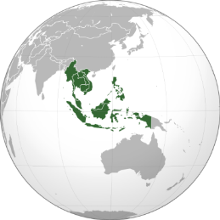
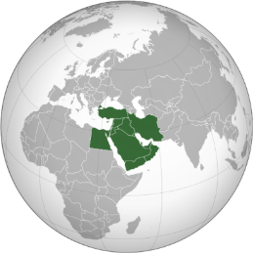
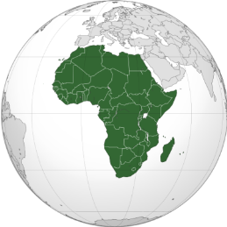
Regional Alignment
MARSOC focuses on three GCCs
Each MRB regionally aligned to a TSOC, habitually supporting a specific SOC(Fwd) or sub-region
Each MRSB oriented to provide habitual support to an aligned MRB
Enduring partnerships with TSOCs, Theater MARFORs, Country Teams, and Partner Nation forces
Maintain a persistently forward deployed integrated, full spectrum SOF capability (Reinforced MSOC) in each target region
1st MRB
1st MRSB
2d MRB
2d MRSB
3d MRB
3d MRSB
Southeast Asia
Gulf Cooperation Council (TBD)
Northwest Africa

Slide 12
MARSOC RST
USSOCOM
COCOM Chaplain
CH(COL) Youstra
HQMC
Chaplain of USMC
RDML Todd
MARSOC
Force Chaplain/RP
CAPT Axtell/RP1 Cambiado
MRSG
Deputy Force/Group Chaplain
* LCDR Hogan/[Gapped]
MRR
Regimental HQ Chaplain
* LCDR Hogan
MRTC
Chaplain
(LT Matson, Reservist)
1st MRSB
Chaplain/RP
LT Johnson/RP2 Tengco
1st MRB
Chaplain
LT Johnson/RP2 Tengco
2nd MRSB
Chaplain
LCDR Wesson/RP2 Gray
2nd MRB
Chaplain
LCDR Wesson/RP2 Gray
Force Structure Challenges
MRTC Active Duty Billet
1 RP needed per RST
RST deployments
3rd MRSB
Chaplain
LT Tungett/RP2 Gaddy
3rd MRB
Chaplain
LT Tungett/RP2 Gaddy

Slide 13
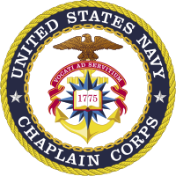
MARSOC RST Selection
REQUIREMENTS
Receive nomination from Chaplain Corps Detailer
Letters of Recommendation from CO & Supervisory Chaplain
Interview w/ MARSOC Chaplain & receiving Unit
FMF Qualification for supervisory assignments
PLUSES
TS-SCI eligible
Previous SOF experience for supervisory assignments
REQUIRED Qualifications
Introduction to SOF (online)
Joint Religious Support Team Orientation
Full-spectrum SERE
FMF Qualification
Advanced Joint Religious Support Team Certificate (optional)
Jump School (optional)

Slide 14
Role of the Religious Program Specialists (RPs)
Capabilities of RPs
Admin/logistics
Financial/Budget Management
Counseling triage
Interpersonal communication
Protection of confidential/privileged communication
Deck-plate ministry/leadership
Community relations projects
Physical security of assigned unit Chaplain
Qualifications/Expectations
Current Annual Training Requirements
Enlisted FMF Qualification/Requalification
Current Specialized Training
Challenges
Gapped billets/Turnover/Skills
Deployment as RST

Slide 15
MPOTFF
Marine Raider RSTs are integral to the MPOTFF team
Commander’s #1 priority – one-stop shop for:
Spiritual Performance
Human Performance
Unit, Personal, and Family Readiness
Medical
Safety
Transition Management
Integrated, synchronized, multi-disciplinary team

Slide 16
MPOTFF
Body
PFT/CFT
Critical Thinking
Mind
Sports
psychology
Combat
Athlete
Warrior transition (home location decompression)
Nutrition
Rapid
recovery
Stress screening
Strength/conditioning
Dependency
avoidance
Mental health
Human
Factors
Quality of life
Stress
coping
Family
readiness
Physical therapy
Positive experiences
Life meaning
Financial
security
Personal quest
Esprit de corps
Unit cohesion
Marriage enrichment
Pastoral care
Holistic Integration of
Preservation of the Force and Families
Spirit

Slide 17
Spiritual Fitness ALMAR
R 031813Z Oct 16
ALMAR 033/16
MSGID/GENADMIN/CMC WASHINGTON DC DMCS//
SUBJ/SPIRITUAL FITNESS//
GENTEXT/REMARKS/1. Fitness is a vital part of being a United States Marine. Although we all understand the importance of being physically fit, it is also important to remember the other three aspects of overall fitness: spiritual, mental, and social. All of these aspects are essential to the well-being of each individual Marine and Sailor, and our Corps as a whole.
2. As Americas force in readiness, we must be prepared to answer our Nations call on a moments notice. A large part of that ability is our capacity for resilience. Regardless of the battle we just fought, we must be ready for our next success. Research indicates that spiritual fitness plays a key role in resiliency, in our ability to grow, develop, recover, heal, and adapt. Regardless of individual philosophy or beliefs, spiritual well-being makes us better warriors and people of character capable of making good choices on and off duty.
3. Beginning in October, the Marine Corps will be emphasizing all components of fitness, particularly the physical and spiritual aspects. During this time, I ask each of you to reflect on what you and the Marines and Sailors you lead are doing to achieve and maintain an optimal level of strength and resilience. Your leaders and chaplains at all levels stand ready to engage with you in this task. By attending to spiritual fitness with the same rigor given to physical, social and mental fitness, Marines and Sailors can become and remain the honorable warriors and model citizens our Nation expects.
4. Semper Fidelis, Robert B. Neller, General, U.S. Marine Corps, Commandant of the Marine Corps//

Slide 18
Spiritual Fitness Guides
Based on the COSC model, a private self-assessment tool divided into 4 levels of fitness…
FIT | STRESSED | DEPLETED | DRAINED
Potential Indicators | Potential Indicators | Potential Indicators | Potential Indicators
1. Engaged in life’s meaning/purpose | Neglecting life’s meaning/purpose | Losing a sense of life’s meaning/purpose | Feels like life has no meaning/purpose
2. Hopeful about life/future | Less hopeful about life/future | Holds very little hope about life/future | Holds no hope about life/future
3. Makes sound moral decisions | Makes some poor moral decisions | Makes poor moral decisions routinely | Engaged in extreme immoral behavior
4. Fully engaged with family, friends, and community | Somewhat engaged with family, friends, and community | Weakly engaged with family, friends, and community | Not engaged with family, friends, or community
5. Able to forgive self and others | Difficulty forgiving self or others | Not likely to forgive self or others | Forgiveness is not an option
6. Respectful of others | Less respectful of others | Strong disrespect for others | Complete disrespect for others
7. Engaged in core values/beliefs | Straying from core values/beliefs | Disregards core beliefs/values | Abandoned core values/beliefs
Only meant to be used as private self-assessment tool – not designed to evaluate a Marine’s spiritual fitness.
Commands should not mandate the use of the SFG or require a Marine to disclose self-assessment results.
Training on this topic is encouraged – must be conducted by a chaplain or under a chaplain’s supervision.

Slide 19
Elements of Spiritual Fitness
Maintained by exercising three elements: Faith, Values, Morals
Personal Faith
All Marines have the ability to make a personal choice in which they will place their personal faith.
Faith may be characterized as belief or trust in self and/or a relationship with someone or something greater than one’s self.
Foundational Values
All Marines have the ability to make a personal choice regarding the values they will live by.
That, in turn, guide their choices, actions, and the character they display on and off duty.
Moral Living
All Marines make personal choices about the sources that guide moral living and the decision making process.
Marines must reflect upon and evaluate past decisions in order to inform their current and future decisions.

Slide 20
MARSOC Spiritual Fitness
Religious Services & Studies – Divine Services at Mess Hall, Tun Tavern Fellowship, “Raising a Modern Day Knight,” “Becoming a Leader of Character,” and battle field circulation.
Spiritus Invictus Training (A&S) – Focuses on Spiritual Fitness & personal growth to persevere, overcome and achieve.
Commander’s Devotions – Prayer/devotions with MARSOC Commanders.
MCSOC Ethical Engagement – Seeks for Raiders to further develop an ethical framework reinforced by leader-led case studies.
MRTC Tactical Ethics Program – Developed in consultation with MRTC Chaplain, an instructor-led program being developed by the Citadel’s Krause Center.
All-Hands Briefs – Discussion on how spirituality shapes moral/ethical decision making.
Home Location Decompression (HLD) – Post-deployment screening of all Raiders.
Marriage Workshops – Marriage enhancement programs for couples.
Family and CREDO Retreats – SOF specific weekend family & marriage retreats.
Faith
Values
Morals
Ministry of Presence

Slide 21
MARSOC RST Strategy
Take a positive approach to Spiritual Fitness focusing on strength, success and achievement – not just averting crisis.
Continue to assess our population – adapt programs to meet the needs of our unique context.
Further develop a full spectrum CRP that utilizes the Marine Corps Spiritual Fitness construct – faith, values, morals.
Continue to foster a culture of interdisciplinary cooperation and dialogue at every level – MPOTFF.
Develop Chaplain and Religious Program Specialist led Spiritual Fitness training.
Integrate Spiritual Fitness at all levels to remind our Raiders at every opportunity the meaning of their mission.

